Slide 1

Module 8: Arrays, Vectors, & Data Parallelism
PURPLE GROUP
Notes:
Presentation Slides created by April Crockett, Tennessee Tech University

Slide 2
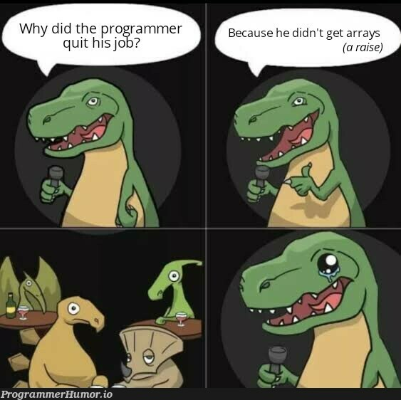
What is an Array?
An array is a single variable that can store multiple values of the same type. Values are stored in adjacent memory locations.
Each item in an array is called an element.
Each element’s location number is called the index or subscript.
Arrays are BUILT IN to the C++ language (unlike Python).

Slide 3
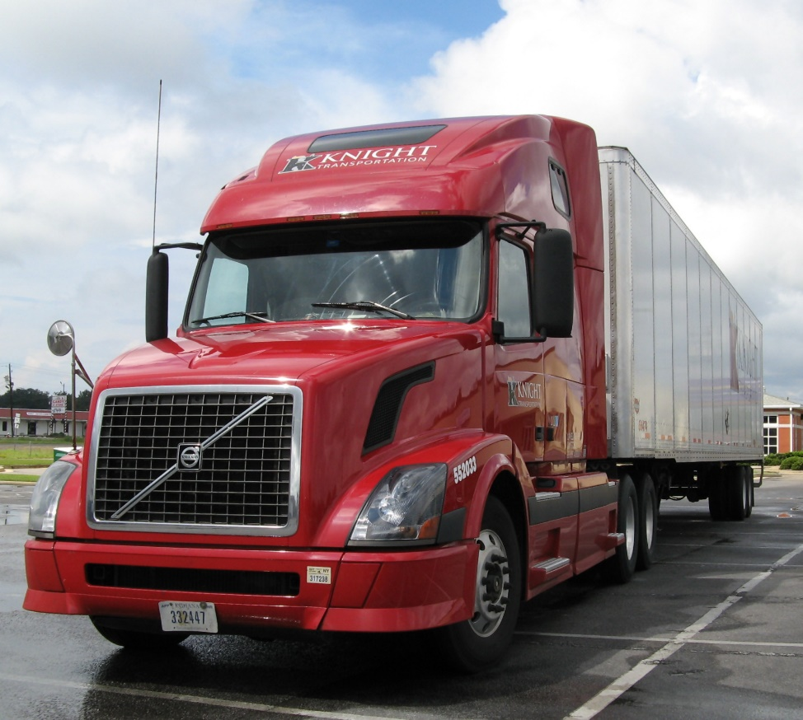
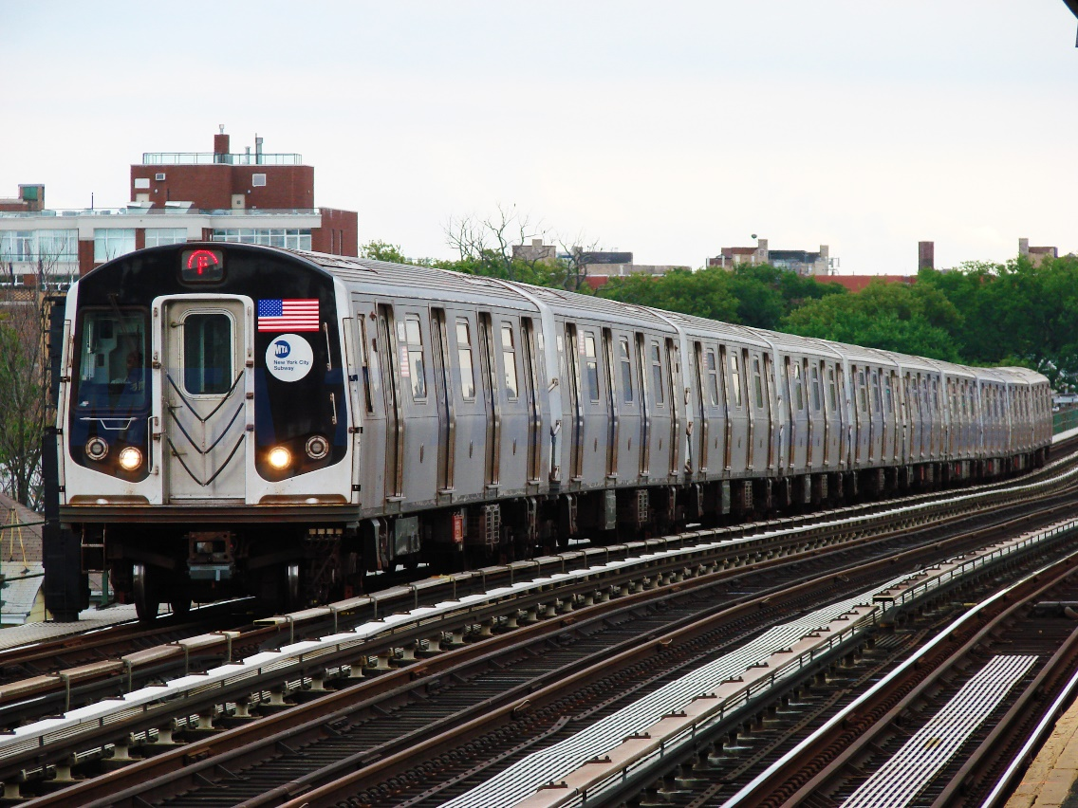
Array Concept
A single variable is like a truck whereas an array is like attached train cars.
vs.
Single Variable (tractor trailer)
Array (attached train cars)
This Photo by Unknown Author is licensed under CC BY-SA
This Photo by Unknown Author is licensed under CC BY-SA

Slide 4

Array Declaration
An array is declared using the [] operator
int tests[5];
The variable definition above creates a five-element integer array and allocates the following in memory:
first element | second element | third element | fourth element | fifth element

Slide 5
Array Terminology: Size Declarator
int tests[5];
int is the data type of all the array elements.
tests is the name of the array
[] are square brackets (not curly braces or parenthesis)
5, in [5], is the size declarator. It determines the number of elements in the array.

Slide 6
Size of Array in Memory
The size of an array is:
the total number of bytes allocated for it
(number of elements) * (number of bytes for each element)
Example:
int tests[5] is an array of 20 bytes,
assuming 4 bytes for an int

Slide 7
Named Constants as Size Declarators
Named constants are commonly used as size declarators. const int SIZE = 5; int tests[SIZE];
This eases program maintenance when the size of the array needs to be changed because it will only need to be changed in one place.

Slide 8
Accessing Array Elements with an Index
Each element in an array is assigned a unique index.
Index numbers start at 0
The last element’s index is n-1 where n is the number of elements in the array.
Index: 0 1 2 3 4

Slide 9
Accessing Array Elements with Index Value
Array elements can be used as regular variables:
tests[0] = 79;
cout << tests[0];
cin >> tests[1];
tests[4] = tests[0] + tests[1];
Arrays must be accessed via individual elements:
cout << tests; //prints memory address, not values

Slide 10
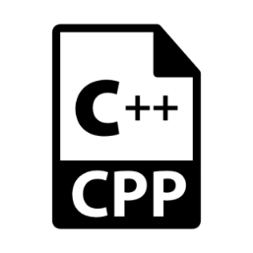
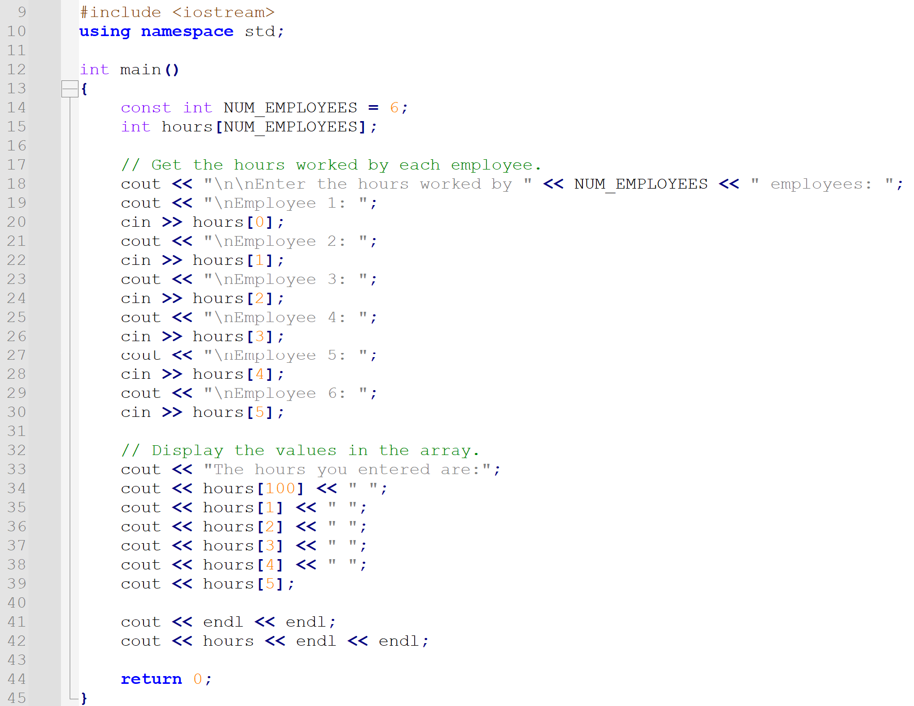
Array Example
arrayExample_0.cpp

Slide 11
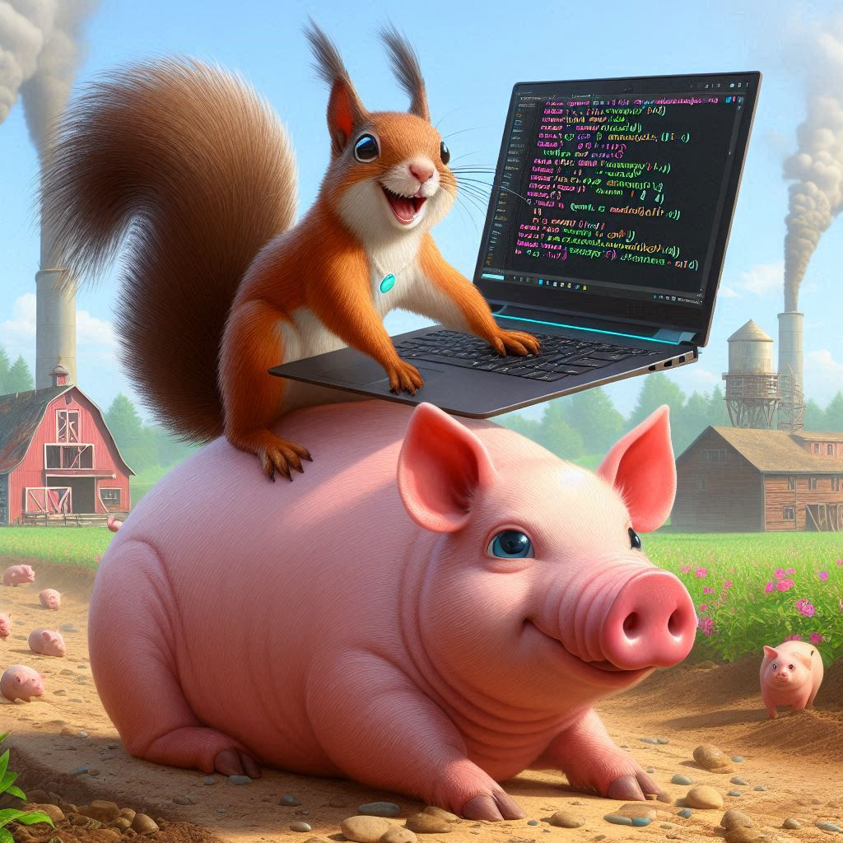
Iterating Through Arrays

Slide 12
Iterating Through Arrays with For Loop
Example – The following code defines an array, numbers, and assigns 99 to each element:
The variable i starts at 0, which is the first valid index value
const int ARRAY_SIZE = 5;
int numbers[ARRAY_SIZE];
for (int i = 0; i < ARRAY_SIZE; i++)
numbers[i] = 99;
loop ends when the variable i reaches 5, which is the first invalid index value
0 | 1 | 2 | 3 | 4
99 | 99 | 99 | 99 | 99

Slide 13
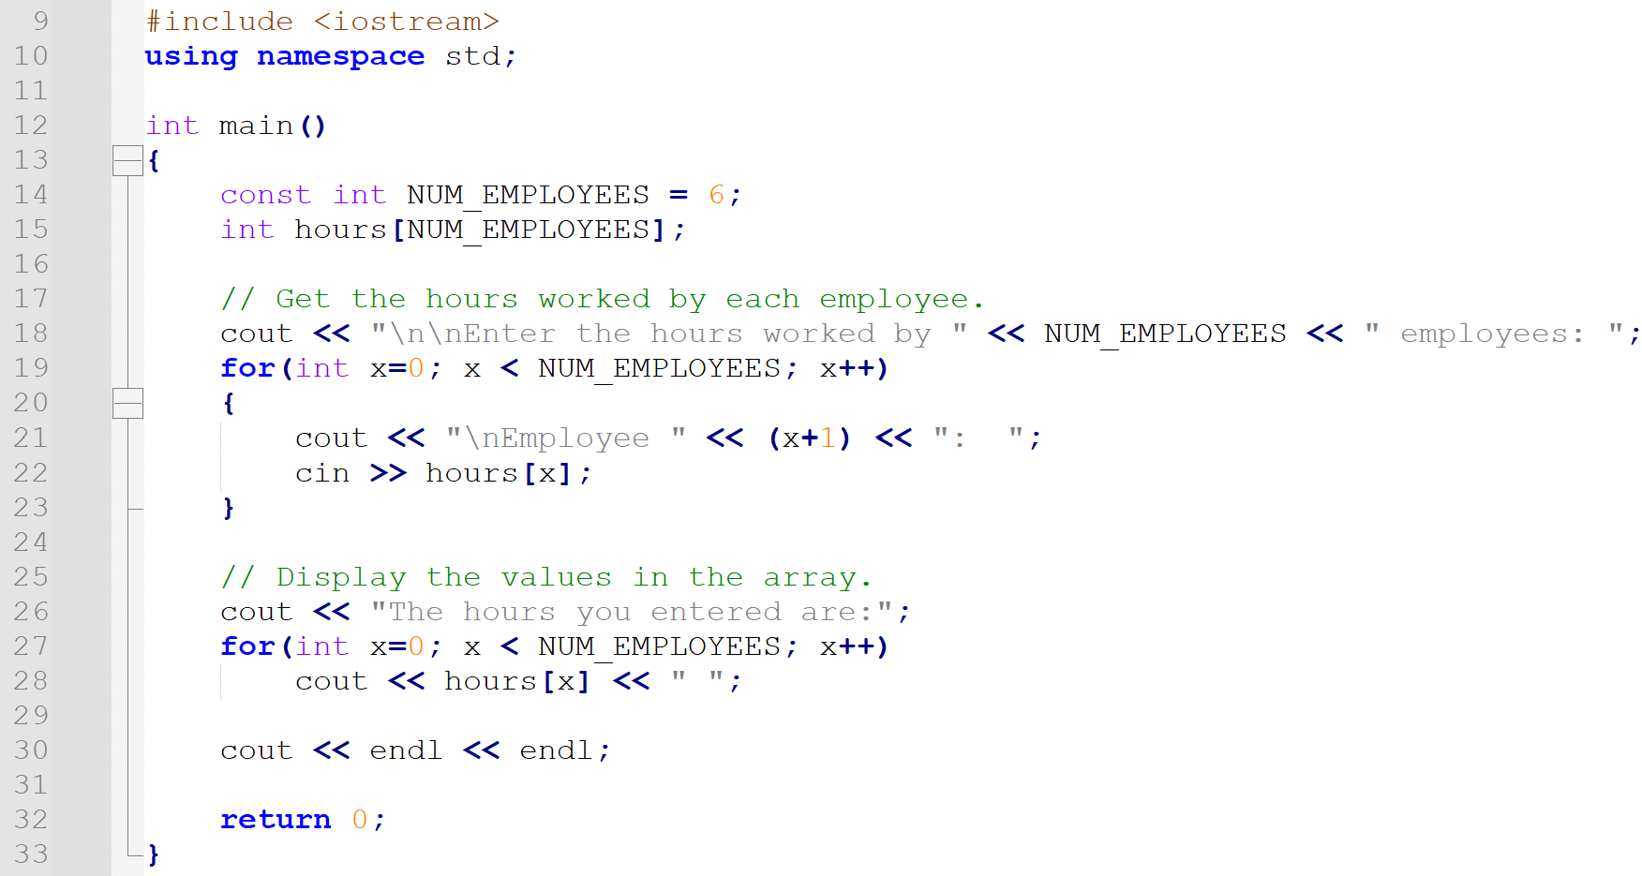
Array Example with For Loop
arrayExample_1.cpp
This example iterates through an array using a for loop.

Slide 14

No Bounds Checking in C++
When you use a value as an array index, C++ does not check it to make sure it is a valid index.
In other words, you can use an index that is beyond the bounds of the array. This can corrupt other memory locations, crash program, or lock up computer, cause elusive bugs and possibly the end of the world.

Slide 15
Off-By-One Errors
An off-by-one error happens when you use an array index that is off by one.
This can happen when you start at index 1 rather than 0:
// This code has an off-by-one error.
const int SIZE = 100;
int numbers[SIZE];
for (int count = 1; count <= SIZE; count++)
numbers[count] = 0;

Slide 16
Iterating Through Array Examples
arrayExample_2.cpp reads data from a file into an array
arrayExample_3.cpp writes the contents of an array to a file
arrayExample_4.cpp demonstrates going out of bounds of an array

Slide 17
Module 8 In-Class Practice 1
Write a program named mod8a.cpp.
In the program, ask the user to provide the name and price of ten things that is useful in life (Example: duct tape, $3.99).
Store the names of the useful items in a string array. Store the prices in a separate double array.
Then, iterate through both arrays to print out the ten items & prices as you see in the sample output.
Tell me 10 useful things and their price:
USEFUL THING 1: Duct Tape
PRICE FOR THING 1: 3.99
USEFUL THING 2: Super Glue
PRICE FOR THING 2: 4.99
USEFUL THING 3: Sharpie
PRICE FOR THING 3: 2.99
USEFUL THING 4: Band-Aid
PRICE FOR THING 4: 5
USEFUL THING 5: Tylenol
PRICE FOR THING 5: 1.99
USEFUL THING 6: Smart Phone
PRICE FOR THING 6: 1248.50
USEFUL THING 7: Rain Boots
PRICE FOR THING 7: 39.99
USEFUL THING 8: Paperclip
PRICE FOR THING 8: .05
USEFUL THING 9: Scissors
PRICE FOR THING 9: 7.99
USEFUL THING 10: Swiss Army Knife
PRICE FOR THING 10: 80
Your list of useful items include:
Duct Tape, $3.99
Super Glue, $4.99
Sharpie, $2.99
Band-Aid, $5.00
Tylenol, $1.99
Smart Phone, $1248.50
Rain Boots, $39.99
Paperclip, $0.05
Scissors, $7.99
Swiss Army Knife, $80.00

Slide 18
Foreach Loop
foreach loop (also called range-based for loop) is used to iterate over the elements in an array quickly without performing initialization, testing, and updating.
Use the keyword for, rest of the syntax is different from the C++ for loop.
The working of foreach loops is to do something for every element rather than doing something n times.
double numbers[100];
for (double num : numbers)
cout << num << endl; //prints each element
data type of elements in the array
colon
array name

Slide 19
Using auto with Foreach Loop
The auto keyword (introduced in C++ 11) allows for type inference and is commonly used in the foreach loop.
Type inference refers to automatic determination of the data type.
double numbers[100];
for (auto num : numbers)
cout << num << endl;

Slide 20
Assignment in a Foreach Loop
When doing assignment with a foreach loop, you must use a reference to the element so that you are changing the contents of the element and not just accessing it.
Use an ampersand & to reference the variable.
double numbers[100];
for (auto & num : numbers)
num = 99.9; //assign 99.9 to each element

Slide 21
Foreach Example
foreach_1.cpp Uses a foreach loop to assign a value to each element of the array and then uses another foreach loop to print the array contents to the screen.
foreach_2.cpp Uses a foreach loop with a string array.

Slide 22

Common Array Algorithms

Slide 23
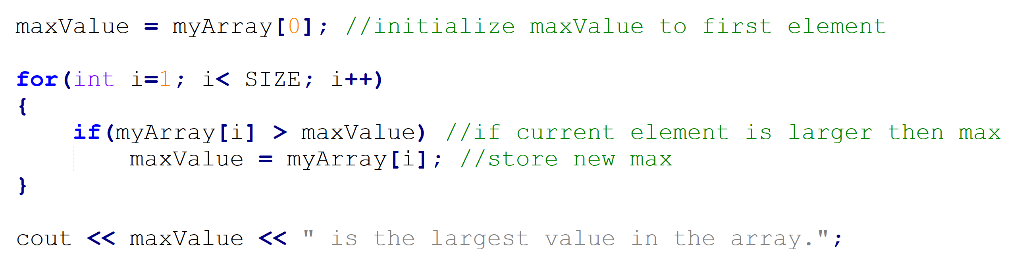
Find Maximum Value Algorithm

Slide 24
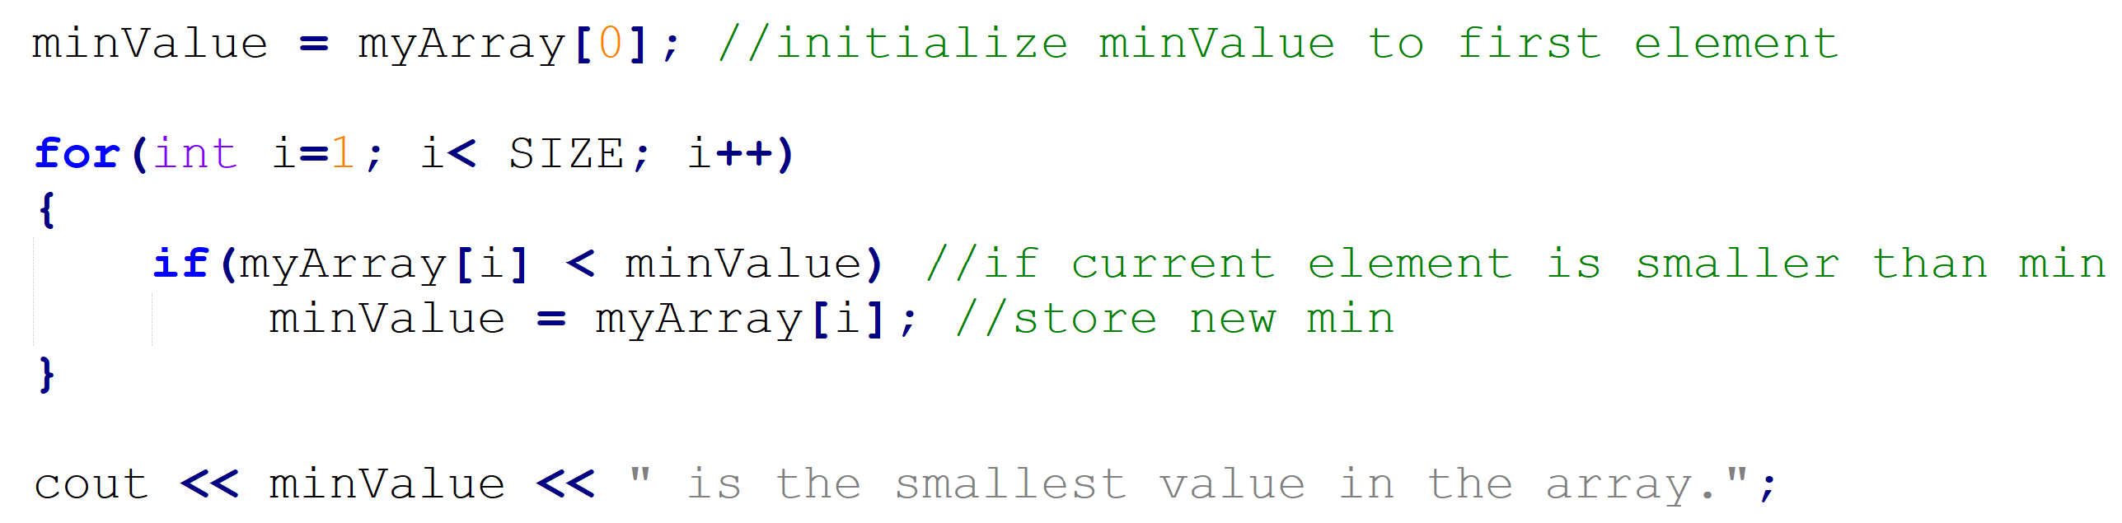
Find Minimum Value Algorithm

Slide 25
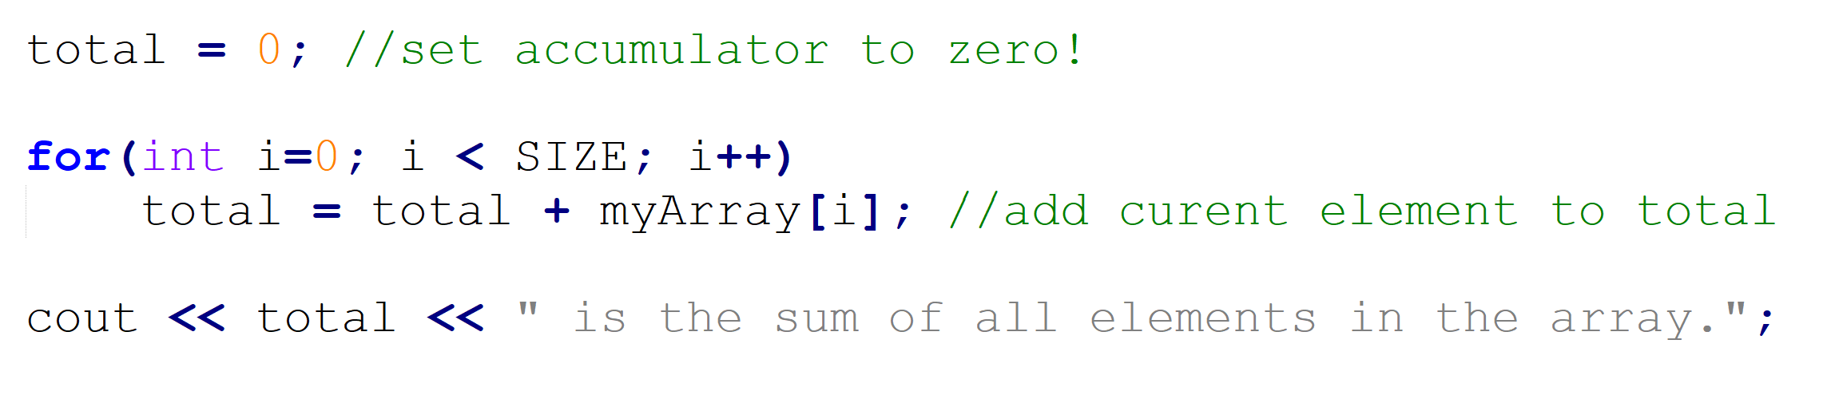
Find Sum of All Elements Algorithm

Slide 26
Array Examples
arrayExample_5.cpp stores (in an array) hours worked by employees
arrayExample_6.cpp gets a series of test scores and calculates average with the lowest score dropped. Also finds the highest score.

Slide 27

Array Initialization

Slide 28
Array Initialization with an Initialization List
Arrays can be initialized with an initialization list: const int SIZE = 5; int tests[SIZE] = {79,82,91,77,84};
The values are stored in the array in the order in which they appear in the list.
The initialization list cannot exceed the array size.
79 | 82 | 91 | 77 | 84

Slide 29
Partial Array Initialization
Arrays can be partially initialized: const int SIZE = 5; int tests[SIZE] = {79,82,91}; int other[SIZE] = {0};
The values are stored in the array in the order in which they appear in the list.
The fourth and fifth elements are automatically initialized to zero.
79 | 82 | 91 | 0 | 0

Slide 30
Implicit Array Sizing
The compiler can determine the array size by the size of the initialization list instead of the size declarator.
This is called implicit array sizing.
Below, quizzes is a 4-element array. int quizzes[] = {12, 17, 15, 11};
A FULL initialization list is required.
12 | 17 | 15 | 11

Slide 31
Array Initialization Examples
arrayInitialize_1.cpp contains an integer array and a double array with a full initialization list
arrayInitialize_2.cpp contains a string array with a full initialization list and a Boolean array with a full initialization list using implicit array sizing

Slide 32

Passing Arrays to Functions

Slide 33
Arrays are Passed by Reference to Functions
When you pass an array to a function, it is passed by reference instead of by value because the array name is the memory address of the array.
Usually, the size of the array is passed as an additional argument unless the array size is defined as a global constant.

Slide 34
Passing Array to Function Example, Slide 1 of 3
In the function prototype, you put the data type of the array and empty square brackets.
In the function call statement, you only put the name of the array. Do not put the data type or square brackets.
In the function header, you put the data type, name of the array, and empty square brackets for the array parameter.
void printArr(short[], int);
int main() { short dice[6] = {1,2,3,4,5,6}; printArr(dice, 6); return 0; }
void printArr(short dice[], int size) { for(auto d : dice) cout << d << endl; }

Slide 35
Passing Array to Function Example, Slide 2 of 3
In the function prototype, you put the data type of the array and empty square brackets.
In the function call statement, you only put the name of the array. Do not put the data type or square brackets.
In the function header, you put the data type, name of the array, and empty square brackets for the array parameter.
void printArr(short[], int);
int main() { short dice[6] = {1,2,3,4,5,6}; printArr(dice, 6); return 0; }
void printArr(short dice[], int size) { for(auto d : dice) cout << d << endl; }

Slide 36
Passing Array to Function Example, Slide 3 of 3
In the function prototype, you put the data type of the array and empty square brackets.
In the function call statement, you only put the name of the array. Do not put the data type or square brackets.
In the function header, you put the data type, name of the array, and empty square brackets for the array parameter.
void printArr(short[], int);
int main() { short dice[6] = {1,2,3,4,5,6}; printArr(dice, 6); return 0; }
void printArr(short dice[], int size) { for(auto d : dice) cout << d << endl; }

Slide 37
Passing Arrays to Function Code Example
arrayFunc_1.cpp passing an array to two different functions

Slide 38
Module 8 In-Class Practice 2
Take your mod8a.cpp and rename it to mod8b.cpp.
Add the following to the program:
Create a function called findHighest(). Send the price array to this function and find the largest amount in the array. Return the index of the element with the largest price.
Create a function called findAverage(). Send the price array to this function and find the average of all prices. Return the average price.
In the main function, add to the end of the function to call findHighest(), findAverage(), and then print the results as you see in the output below.
Tell me 10 useful things and their price:
USEFUL THING 1: Duct Tape
PRICE FOR THING 1: 3.99
USEFUL THING 2: Super Glue
PRICE FOR THING 2: 4.99
USEFUL THING 3: Sharpie
PRICE FOR THING 3: 2.99
USEFUL THING 4: Band-Aid
PRICE FOR THING 4: 5
USEFUL THING 5: Tylenol
PRICE FOR THING 5: 1.99
USEFUL THING 6: Smart Phone
PRICE FOR THING 6: 1248.50
USEFUL THING 7: Rain Boots
PRICE FOR THING 7: 39.99
USEFUL THING 8: Paperclip
PRICE FOR THING 8: .05
USEFUL THING 9: Scissors
PRICE FOR THING 9: 7.99
USEFUL THING 10: Swiss Army Knife
PRICE FOR THING 10: 80
Your list of useful items include:
Duct Tape, $3.99
Super Glue, $4.99
Sharpie, $2.99
Band-Aid, $5.00
Tylenol, $1.99
Smart Phone, $1248.50
Rain Boots, $39.99
Paperclip, $0.05
Scissors, $7.99
Swiss Army Knife, $80.00
****RESULTS****
HIGHEST PRICE: Smart Phone with price $1240.50
AVERAGE PRICE: $139.10
****RESULTS****
HIGHEST PRICE: Smart Phone with price $1240.50
AVERAGE PRICE: $139.10

Slide 39

Parallel Arrays

Slide 40




What are Parallel Arrays?
Parallel arrays are two or more arrays that contain related data.
The array index is used to relate arrays.
Elements using the same index are related.
The parallel arrays may be of different data types.
studentName
Billy Dean | Jack Black | Jolie Jolene | Elvis Presley | Bob Ross
studentGPA
3.46 | 2.61 | 3.79 | 3.24 | 3.15

Slide 41
Parallel Array Code Example
const int SIZE = 5; // Array size
int id[SIZE]; // student ID
double average[SIZE]; // course average
char grade[SIZE]; // course grade
...
for(int i = 0; i < SIZE; i++) {
cout << "Student ID: " << id[i]
<< " average: " << average[i]
<< " grade: " << grade[i]
<< endl;
}
In this example, id, average, and grade are parallel arrays.

Slide 42

Two-Dimensional Arrays

Slide 43
What are Two-Dimensional Arrays?
You may define one array for multiple sets of data.
A 2D array is like a table in a spreadsheet.
To define a two-dimensional array, use two size declarators in the variable definition: const int ROWS = 4, COLS = 3; int exams[ROWS][COLS];
The first declarator is always the number of rows and the second size declarator is always the number of columns.

Slide 44
Two-Dimensional Array Declaration
const int ROWS = 4, COLS = 3; int exams[ROWS][COLS];
columns
r
o
w
s
exams[0][0] | exams[0][1] | exams[0][2]
exams[1][0] | exams[1][1] | exams[1][2]
exams[2][0] | exams[2][1] | exams[2][2]
exams[3][0] | exams[3][1] | exams[3][2]

Slide 45
Assigning a Value in a 2D Array
const int ROWS = 4, COLS = 3; int exams[ROWS][COLS];
Use two indexes to access element:
exams[2][2] = 86;
columns
r
o
w
s
exams[0][0] | exams[0][1] | exams[0][2]
exams[1][0] | exams[1][1] | exams[1][2]
exams[2][0] | exams[2][1] | 86
exams[3][0] | exams[3][1] | exams[3][2]

Slide 46
Passing Two-Dimensional Arrays to a Function, slide 1 of 3
Use global constants for the row & column size declarators. In the function prototype, put the data type of the 2D array and two sets of square brackets with the number of columns in the column size declarator.
In the function call statement, you only put the name of the array. Do not put the data type or square brackets.
In the function header, you put the data type, name of the array, empty square brackets for rows, and square brackets with the size declarator of the columns.
const int ROWS = 2; const int COLS = 3;
void printArr(short[][COLS]);
int main() { short arr[ROWS][COLS] = {{3,6,9}, {1,4,8}}; printArr(arr); return 0; }
void printArr(short arr[][COLS]) { for(int r=0; r<ROWS; r++) { for(int c=0; c<COLS; c++) { cout << arr[r][c] << endl; } } }

Slide 47
Passing Two-Dimensional Arrays to a Function, slide 2 of 3
Use global constants for the row & column size declarators. In the function prototype, put the data type of the 2D array and two sets of square brackets with the number of columns in the column size declarator.
In the function call statement, you only put the name of the array. Do not put the data type or square brackets.
In the function header, you put the data type, name of the array, empty square brackets for rows, and square brackets with the size declarator of the columns.
const int ROWS = 2; const int COLS = 3;
void printArr(short[][COLS]);
int main() { short arr[ROWS][COLS] = {{3,6,9}, {1,4,8}}; printArr(arr); return 0; }
void printArr(short arr[][COLS]) { for(int r=0; r<ROWS; r++) { for(int c=0; c<COLS; c++) { cout << arr[r][c] << endl; } } }

Slide 48
Passing Two-Dimensional Arrays to a Function, slide 3 of 3
Use global constants for the row & column size declarators. In the function prototype, put the data type of the 2D array and two sets of square brackets with the number of columns in the column size declarator.
In the function call statement, you only put the name of the array. Do not put the data type or square brackets.
In the function header, you put the data type, name of the array, empty square brackets for rows, and square brackets with the size declarator of the columns.
const int ROWS = 2; const int COLS = 3;
void printArr(short[][COLS]);
int main() { short arr[ROWS][COLS] = {{3,6,9}, {1,4,8}}; printArr(arr); return 0; }
void printArr(short arr[][COLS]) { for(int r=0; r<ROWS; r++) { for(int c=0; c<COLS; c++) { cout << arr[r][c] << endl; } } }

Slide 49
2D Array Examples
2darray_1.cpp Two-dimensional array example with initialization lists, printing an array, summing elements.
2darray_2.cpp Two-dimensional array example
2dArrayFunc_2.cpp passing a two-dimensional array to a function

Slide 50

Character Arrays (C-Strings)

Slide 51
Character Array (C-String) Declaration
You can use an array to store a sequence of characters.
Before the C++ String class and in the C programming language, character arrays (c-strings) were the only way to store strings.
Programmers call character arrays c-strings to distinguish them from the C++ String class strings.
The variable definition below defines a c-string that has 20 elements and initializes the c-string.
char movieTitle[20] = “Rogue One”;

Slide 52
Character Arrays (C-Strings) end in a Null Terminator
All c-strings end in a special character known as a null terminator, written as ‘\0’ (this is a backward slash and then a zero).
char month[10] = “April”;
Would be stored in memory as:
month
A | p | r | i | l | \0
0 1 2 3 4 5 6 7 8 9

Slide 53
Output a C-String
Unlike all other arrays, you can print a c-string with a single cout statement without having to have a for or foreach loop. (This is because of the null terminator indicating the end of the string.)
char month[10] = “April”; cout << month << endl; //prints April to the screen

Slide 54
Input with C-Strings
You can read in a string from the user using cin and the extraction operator.
Remember that cin with extraction reads until whitespace is encountered.
char month[10];
cout << “What month is it?”;
cin >> month;

Slide 55
Getline Function for C-Strings
If the user’s input could contain a space (almost always), then you should use the getline function for c-strings instead.
char city[26];
cout << “What city do you live in?”;
cin.getline(city, 26);

Slide 56
C-String Examples
charArrays_1.cpp uses an array of ten characters to store the first ten letters of the alphabet
charArrays_2.cpp demonstrates printing c-strings, initialization list with c-strings, and implicit array sizing.

Slide 57

C-String Library Functions

Slide 58
C-String Library Functions - strlen
There are several c-string library functions you can use when you add #include <cstring> to your program.
The strlen() function returns the number of characters in str up to, but not including, first null terminator.
char fruitOne[10] = “Apple”; cout << strlen(fruitOne); //would print 5
int size = strlen(fruitOne); //would store 5 in size

Slide 59
C-String Library Functions - strcmp
There are several c-string library functions you can use when you add #include <cstring> to your program.
strcmp(str1, str2)
used to compare two string literals or c-strings
Returns an integer – zero if the two strings are identical and either a positive or negative number if they are not.
Case sensitive
char fruitOne[10] = “Apple”; char fruitTwo[10] = “Banana”; if(strcmp(fruitOne, fruitTwo) == 0) //this would be false cout << fruitOne << “ and “ << fruitTwo << “ are the same.\n”; if(strcmp(fruitOne, “Apple”) == 0) //this would be true cout << fruitOne << “ and Apple are the same.\n”;

Slide 60
C-String Library Functions - strcpy
You can’t use the assignment operator with c-strings. For example, if str1 and str are both c-strings, you would get an error for the following statement:
str1 = str2; //ERROR!
str1 = “hello”; //ERROR!
Instead, add #include <cstring> to your program and use the strcpy or strncpy function.
Copies str2 (up to and including null terminator) to str1
char str1[20] = “Hot Sus”; char str2[20] = “Sushi”; strcpy(str1, str2);
cout << str1 << endl; //prints Sushi to the screen
cout << str2 << endl; //prints Sushi to the screen

Slide 61
C-String Library Functions - strncpy
An alternative to strcpy if you want to specify the number of characters to copy is the strncpy function, also in the cstring library.
used to copy n characters from str2 to replace in str1
char str1[20] = “Hot Sus”; char str2[20] = “Sushi”; strncpy(str1, str2, 3);
cout << str1 << endl; //prints Sus Sus to the screen
cout << str2 << endl; //prints Sushi to the screen

Slide 62
C-String Library Functions - strcat
Another function in the cstring library is the strcat() function, which allows you to concatenate (add to the end) or append str2 to the end of str1.
char str1[20] = “Hot ”; char str2[20] = “Sushi”; strcat(str1, str2);
cout << str1 << endl; //prints Hot Sushi to the screen
cout << str2 << endl; //prints Sushi to the screen

Slide 63
C-String Library Functions - strncat
An alternative to strcat if you want to specify the number of characters to copy is the strncat function, also in the cstring library.
Used to concatenate n characters from str2 to the end of str1.
char str1[20] = “Hot ”; char str2[20] = “Sushi”; strncat(str1, str2, 3);
cout << str1 << endl; //prints Hot Sus to the screen
cout << str2 << endl; //prints Sushi to the screen

Slide 64
C-String Library Function Examples
cstringVsStringEx.cpp a program that contains both a C++ String class string and a C-String.
strlenPrac.cpp a program that contains a c-string and uses the strlen, strncat, strcpy, and strcmp function
cstringSTRCMP.cpp a program that allows the user to enter two strings, stored in c-strings and tests to see if they are equal using the strcmp function
strcatPrac.cpp a program that contains multiple c-strings and demonstrates the strcat & strncat functions

Slide 65
Module 8 In-Class Practice 3
Write a program named mod8c.cpp.
In the program, do the following:
Define a 30-element character array named name1 and initialize it to your first name.
Define a string variable named name2 and initialize it to a friend’s first name.
Print out both name1 & name2 to the screen.
Ask the user for their full name and read it in (including spaces) to the name1 variable.
Ask the user for their friend’s full name and read it in (including spaces) to the name2 variable.
Print out both name1 & name2 to the screen again.
Assign “SCOUT” to name1 and assign “JACK” to name2.
Using a loop, print out one character of name1 at a time and add an asterisk ‘*’ so that each letter is separated by a star.
Do step #8 for name2 as well.
name1: APRIL
name2: CRYSTAL
What is your full name? Jessica Fletcher
What is your friend's full name? Amos Tupper
name1: Jessica Fletcher
name2: Amos Tupper
S*C*O*U*T*
J*A*C*K*

Slide 66
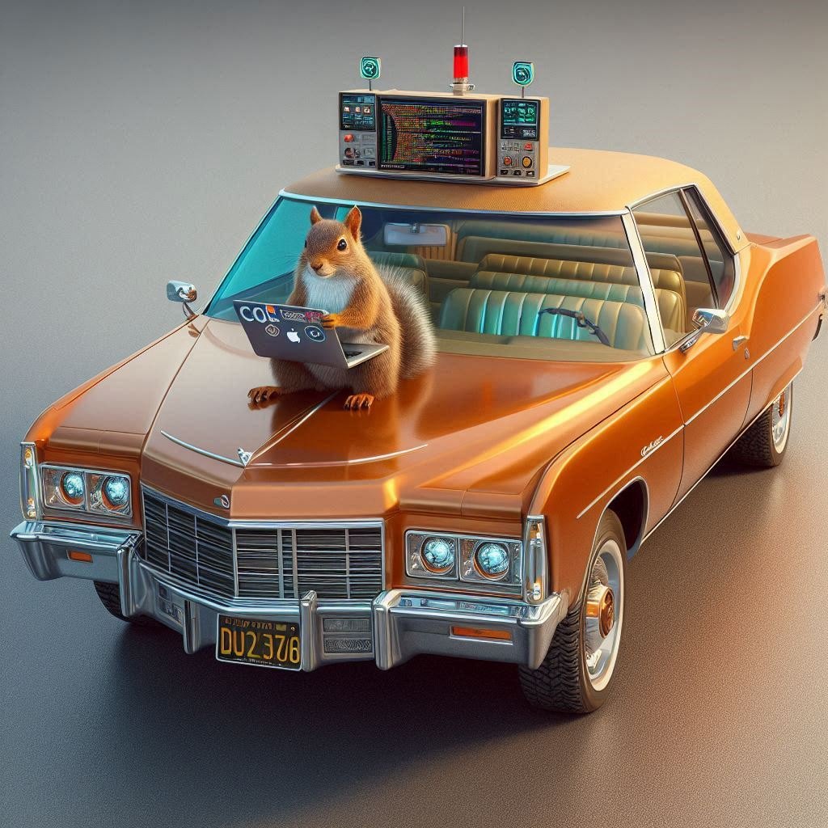
Vectors

Slide 67
Vectors are Similar to Arrays
A Vector is a data type provided by the Standard Template Library (STL) in C++ and they are sequence containers that represent arrays that can change in size.
Each vector item is called an element and can be accessed through an index like an array.
All elements are the same data type.
Elements are stored in contiguous storage locations in memory.

Slide 68
Create a Vector
To create a vector, you must first include the vector library. #include <vector>
In your code you can then define your vector: vector <datatype> variableName(numElements);
For example, to create a 100-element integer vector called myNums, the code would be: vector <int> myNums(100);

Slide 69
Access Vector Elements
To access vector elements, you must use an index number and like arrays, index numbers begin with zero.
Use the at() function to access a specific element.
vector <int> myNums(100);
myNums.at(0) = 7; //assigns 7 to the first element

Slide 70
Initializing a Vector
A vector’s elements are automatically initialized to zeros during the variable definition (unlike arrays).
All elements may be initialized to a different single value.
For example, the definition below will initialize all 100 elements of the myNums vector to -1 instead of zero. vector <int> myNums(100, -1);

Slide 71
Iterating Through Vectors – For Loop
As with arrays, you can iterate through a vector using a for loop, range-based for loop (foreach), or the for_each function from the algorithm class.
You can get the size of the vector as an unsigned integer using the size() function in the vector class.
For loop example: vector <int> myNums(100); for(unsigned int i=0; i<myNums.size(); i++) { cout << myNums.at(i) << endl; }

Slide 72
Iterating Through Vectors – foreach loop
Range-based for loop (foreach)
vector <int> myNums(100); for(auto num : myNums) { cout << num << endl; }

Slide 73
Iterating Through Vectors – for_each function
The for_each function in the algorithm library will apply a function to each element of the vector. Must #include <algorithm>
The function can be a lambda function or a programmer-defined function.
The begin() function in the vector library returns an iterator to the first element. An iterator is an object that points to an element inside the vector and we use iterators to move through the elements in the vector.
The end() function in the vector library returns an iterator to the last element.
vector <int> myNums(100); for_each(myNums.begin(), myNums.end(), [](int &num) {
cout << num << endl;
});

Slide 74
Example Programs
vector1.cpp – create & print vector elements
vector2.cpp – create a vector, put info in a vector using a for loop, find max, find average
vector3.cpp – demonstrates parallel vectors
foreach_vector.cpp – creates a string vector & initializes vector elements, uses a range-based (foreach) loop to prepend the number of characters in the string to the string, prints the vector elements
for_each_vector.cpp – same program as foreach_vector.cpp except uses the algorithm library’s for_each loop

Slide 75
Resizing a Vector
The biggest advantage to using a vector is that you can resize them during runtime using the resize() function.
This is particularly useful if you are creating the number of elements based on user input.
vector<int> myNums; //creates a 0-element vector int size; cout << “How many numbers do you have? “; cin >> size; myNums.resize(size);

Slide 76
Resizing a Vector Example
Another example:
vector<int> myNums(10); myNums.resize(100); //increases size to 100

Slide 77
Example Program
vector4.cpp – uses resize & size function

Slide 78
Vector Functions
There are multiple functions available in the vector library, which can be seen here: https://cplusplus.com/reference/vector/vector/
Some of the most common functions not already mentioned are:
push_back – adds a new element at end of vector and increases vector size by 1
pop_back – removes the last element and decreases vector size by 1
back – accesses last element
front – accesses first element
insert – inserts elements
erase – erase elements

Slide 79
Example Program with Vector Functions
vector5.cpp – demonstrates the vector functions back(), push_back(), and pop_back()

Slide 80
Sort Function in Algorithm Library
In addition to the for_each function, the algorithm library also has a sort() function: https://cplusplus.com/reference/algorithm/sort/
The sort function takes two arguments,
An iterator to the first element in the array or vector (usually accessed with the begin() function)
An iterator to the last element in the array or vector (usually accessed with the end() function)
Example Program: for_each_sort_vector.cpp

Slide 81

Arrays vs. Vectors

Slide 82
Advantages in Arrays vs. Vectors
Advantage of Arrays
Any C++ compiler will be able to handle arrays, because it is part of the C++ language.
Simpler syntax
Slightly more compact (uses less space in memory) and more time efficient when working with large amounts of data.
Advantage of Vectors
You can resize a vector.
You can use functions like push_back, pop_back, back
Safer to use (makes sure not to access memory that is out of range)
It doesn’t produce a syntax error, but a runtime error saying “terminate called after throwing an instance of ‘std::out_of_range’”
Example: vector6.cpp (demonstrates going out of bounds and will produce a runtime error)

Slide 83

Data Parallelism

Slide 84
Parallel Computing – Task & Data Parallelism
Parallel computing is when you divide work among multiple processors (cores) to speed up processing.
Two ways to do this:
Task parallelism:
Different tasks are performed simultaneously across different computing units.
Each task can have its own unique instructions and may be working with different pieces of data or resources.
Data parallelism:
The same task or operation is applied to different pieces of data across multiple processing units.
This is common where you have a large data set and want to perform the same calculations on each chunk independently.

Slide 85


Parallel Computing: Task Parallelism
Task parallelism real life example:
You’re managing a restaurant kitchen where different chefs specialize in specific tasks to prepare a meal simultaneously.
One chef is grilling, another is chopping vegetables, and a third is making sauces.
Each chef (task) performs a different action on different ingredients (data).
They don’t need to wait on each other, but together they speed up the meal preparation.
Task parallelism computing example:
A web server handling various client requests.
Some tasks involve processing images, others work on database queries, and others handle user authentication.
Each task can run concurrently & deals with different resources & operations.

Slide 86


Parallel Computing: Data Parallelism
Data parallelism real life example:
Suppose you’re organizing a fundraiser by mailing out invitations. You have a team of volunteers, and each person is assigned a stack of invitations to stuff and label. All volunteers are performing the same task (preparing an invitation) but working on different data (each invitation). By working in parallel, they finish the task faster.
Data parallelism computing example:
In image processing, if you want to apply a filter to every pixel in a large image, you can break the image into smaller chunks and have each processor apply the filter to a different chunk. Each processor applies the same filtering operation, but on different parts of the image data.

Slide 87
Data Parallelism Information
When you dividing data across different processors. The processors are doing the same computation, but on different pieces of data. This is called data parallel.
Data parallelism can be applied on arrays, vectors, and matrices by working on each element in parallel.

Slide 88
Data Parallelism Example, Slide 1 of 2
2 | 4 | 1 | 6 | 3 | 8 | 7 | 2 | 1 | 1 | 8 | 3
If we had the array above with 12 elements and we wanted to write code to add all the array elements, we could either have our code
perform the addition sequentially (serially), which is one addition at-a-time or
Divide the data between processors, and each processor will add its part of the answer. Once the data is divided, the processors can add their elements independently without need to share any part of the answer until the end, when the results are added together to get the final total.

Slide 89
Data Parallelism Example, Slide 2 of 2
2 | 4 | 1 | 6 | 3 | 8 | 7 | 2 | 1 | 1 | 8 | 3
Serial Operations:
2 + 4 = 6
6 + 1 = 7
7 + 6 = 13
13 + 3 = 16
16 + 8 = 24
24 + 7 = 31
31 + 2 = 33
33 + 1 = 34
34 + 1 = 35
35 + 8 = 43
43 + 3 = 46
If each operation takes 1 millisecond, this would take 13 milliseconds total.
Parallel Operations:
Divide array in 3 equal sections of 4 elements each.
PHASE 1 – each processer adds up a portion of the array.
2 + 4 = 6 | 3 + 8 = 11 | 1 + 1 = 1
6 + 1 = 7 | 11 + 7 = 18 | 2 + 8 = 10
7 + 6 = 13 | 18 + 2 = 20 | 10 + 3 = 13
PHASE 2 A “master processor” adds the 3 results 13 + 20 + 13 = 46
If each operation takes 1 millisecond, this would take 4 milliseconds total (instead of 13)

Slide 90
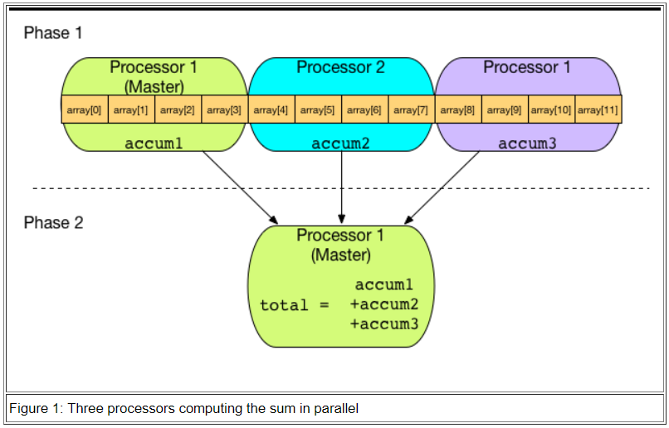
Data Parallelism Terminology
The overall total (calculated in phase 2 in the image on the left) cannot be computed before the completion of computing the local sum by the individual processor. This is called sequential dependency.
The different processors in phase 1 are doing the same computation, but on different pieces of data. This is called data parallel.
[Image taken from https://www.csc.tntech.edu/pdcincs/index.php/ipdc-modules/]

Slide 91
When Use Data Parallelism?
What algorithms can take advantage of data parallelism?
Algorithms on arrays, vectors, or matrix
When data of one element doesn’t depend on the value of another element.
What is an example algorithm where data parallelism wouldn’t help?
Fibonacci sequence - a sequence that follows the rule that each number is equal to the sum of the preceding two numbers. 0, 1, 1, 2, 3, 5, 8, 13, 21……
Although the Fibonacci sequence algorithm uses an array or vector to store a sequence of numbers, this wouldn’t be a good algorithm because data values depend on other values in the sequence.

Slide 92
Data Parallelism in C++
There are two primary options (depending on your development environment) for writing parallel algorithms to accomplish data parallelism in your C++ code.
If you are using Microsoft Visual Studio 2022 (not Visual Studio Code [VSCode]), then you can take advantage of the C++ 17 parallel algorithms: https://devblogs.microsoft.com/cppblog/using-c17-parallel-algorithms-for-better-performance/ such as for_each and use the parallel execution policy.
Otherwise, there is an excellent, widely used API for parallel programming in C++ called OpenMP:
https://www.openmp.org/
https://www.geeksforgeeks.org/introduction-to-parallel-programming-with-openmp-in-cpp/#

Slide 93
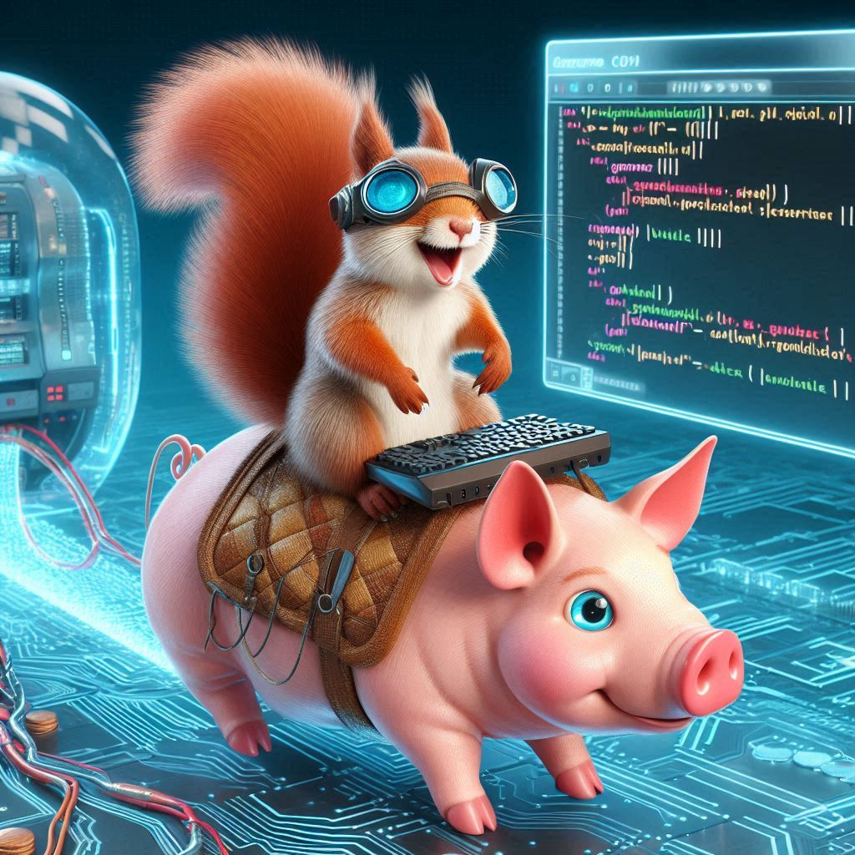
END of
Module 8

